Slide 2
HTML <svg> element
learn about HTML <canvas> element.
practical Implementation of HTML <svg> element.

Slide 3
What is Canvas?
The HTML5 canvas element can be used to draw graphics on the webpage via JavaScript. The canvas was originally introduced by Apple for the Mac OS dashboard widgets and to power graphics in the Safari web browser. Later it was adopted by the Firefox, Google Chrome and Opera. Now the canvas is a part of the new HTML5 specification for next generation web technologies.

Slide 4
What is Canvas?
By default the <canvas> element has 300px of width and 150px of height without any border and content. However, custom width and height can be defined using the CSS height and width property whereas the border can be applied using the CSS border property.

Slide 5
Understanding Canvas Coordinates
The canvas is a two-dimensional rectangular area. The coordinates of the top-left corner of the canvas are (0, 0) which is known as origin, and the coordinates of the bottom-right corner are (canvas width, canvas height). Here's a simple demonstration of canvas default coordinate system.

Slide 6
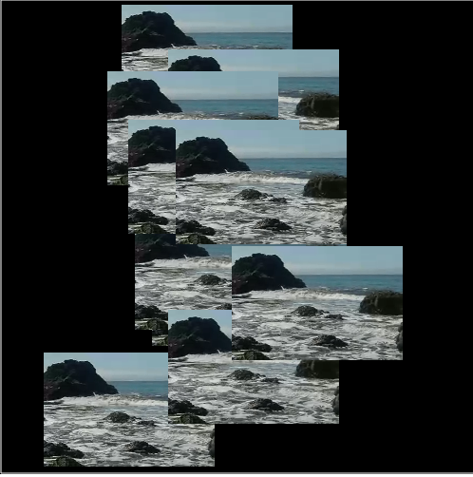
Something Cool The Canvas Can Do
Easily takes a hidden video from
the HTML page, displays it
multiple times, moves each copy
Independently it around
the screen, while playing it.

Slide 7
What is the HTML5 Canvas?
The HTML5 Canvas is an Immediate Mode bit-mapped area of the screen that can be manipulated with JavaScript and CSS.

Slide 8

What Is Immediate Mode?
Immediate Mode refers to the way the canvas renders pixels on the screen. The HTML5 Canvas completely redraws the bitmapped screen on every frame using Canvas API calls from JavaScript. As a programmer, your job is to set-up the screen display before each frame is rendered.

Slide 9
What Is Retained Mode?
Flash, Silverlight, and DOM <div> manipulation techniques use Retained Mode. In Retained Mode a list of individual display objects is stored and manipulated.

Slide 10
HTML5 Canvas Support
Support for the Canvas is growing.
Chrome
Safari (Mac and iOS 5)
I.E. 9 (surprised?)
Firefox
Opera

Slide 11
What Can The Canvas Be Used for?
Nearly anything that Flash notorious for:
Banner Ads
Animated Landing Pages
Web Games
Video

Slide 12

Canvas Banner Ad
Should be put in an <iframe>
PNG sequence but could easily be dynamically generated Canvas text

Slide 13
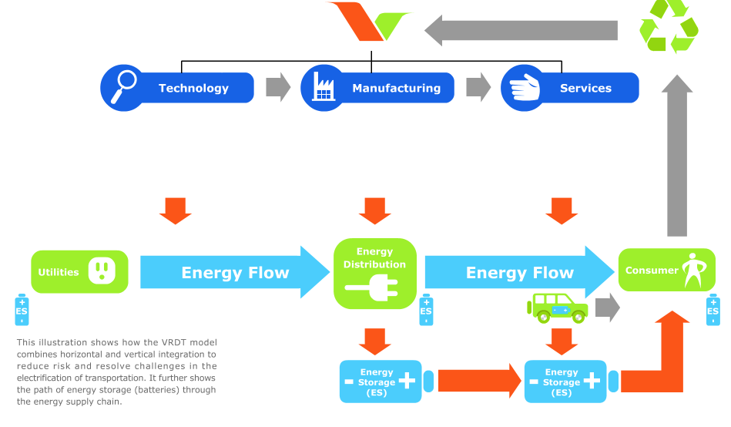
Animated Landing Pages

Slide 14

Web game
Targets all HTML5 devices

Slide 15
Web game
Targets all HTML5 devices
Mobile/Web

Slide 16
Web game
Targets all HTML5 devices
Mobile/Web
Touch Controls Only

Slide 17
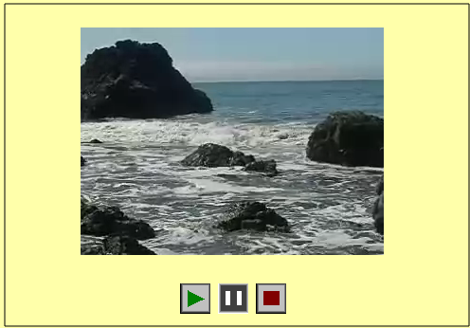
Video
Video played

Slide 18
Video
Video played
Directly on Canvas

Slide 19
Video
Video played
Directly on Canvas
Can Create frame counter

Slide 20
Video
Video played
Directly on Canvas
Can Create frame counter
To trigger events

Slide 21
A Quick Guide To Canvas Development
Next we will describe the Canvas element, its’ properties and methods, then show how to create a simple Canvas application

Slide 22
HTML5 Canvas Properties
Canvas Has Three Properties:
width
height
id
Width and height read/write which means you can resize the Canvas on the fly

Slide 23
HTML5 Canvas Methods
getContext() : You need the context to draw anything on the Canvas.
toDataUrl() : Outputs the bitmapped data of the Canvas to a string (can be used to create a screenshot)

Slide 24
HTML5 Canvas And CSS
CSS can be used in conjunction with Canvas object itself. However, individual drawings on the Canvas cannot be manipulated with CSS
Example: you can scale the Canvas using CSS
style=”width: 400px; height:400px”
Does not resize but instead scales (like setting width ad height for a Flash embed)

Slide 25
Basic Canvas
<!DOCTYPE html>
<html>
<body>
<canvas id = "Ani" height = "200" width = "200"
style = "border:5px solid red">
</canvas>
</body>
</html>

Slide 26
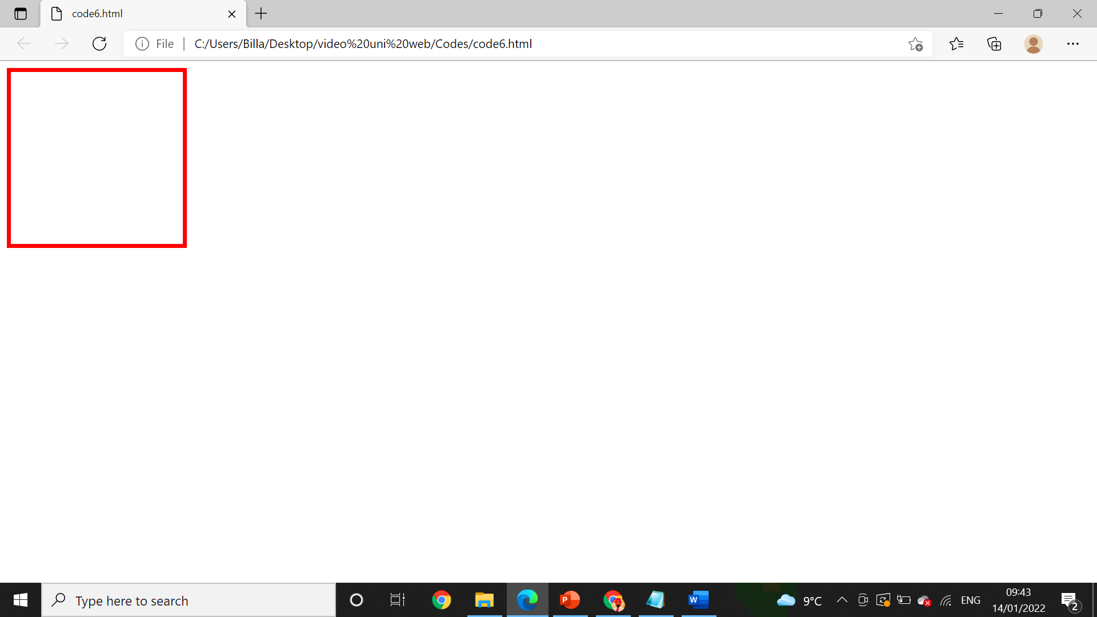
Output

Slide 27
What is SVG?
SVG stands for Scalable Vector Graphics
SVG is used to define graphics for the Web
SVG is a W3C recommendation

Slide 28
The HTML <svg> Element
The HTML <svg> element is a container for SVG graphics.
SVG has several methods for drawing paths, boxes, circles, text, and graphic images.

Slide 29
Example
<!DOCTYPE html>
<html>
<body>
<svg width="100" height="100">
<circle cx="50" cy="50" r="40" stroke="green" stroke-width="4" fill="yellow" />
</svg>
</body>
</html>

Slide 30
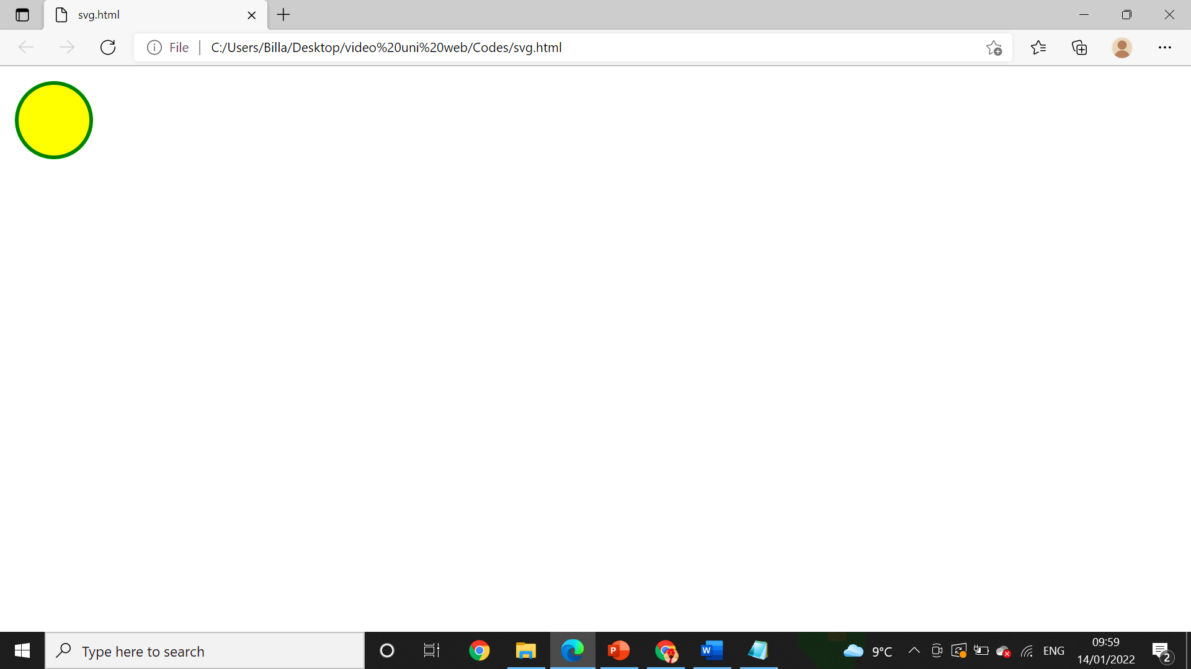
Output

Slide 31

Practical

